Slide 1
CHAITANYA BHARATHI INSTITUTE OF TECHNOLOGY DEPARTMENT OF ELECTRONICS AND COMMUNICATION ENGINEERING
BATCH NUMBER 202
Ashwitha K – 160118735064
Manasvini N – 160118735072
Sanjana M – 160118735079
Guide : Dr. Suman Kshirsagar
Assistant Professor
Department of ECE
CBIT
Hyderabad

Slide 2
DEVELOPMENT OF FARM MONITORING SYSTEM USING IoT

Slide 3
CONTENTS
Abstract
Introduction
Aim
Objectives
Motivation
Literature Survey
Proposed Methodology
Block Diagram
Hardware Implementation
Software Implementation
Results
Conclusion
Future Scope
References

Slide 4
ABSTRACT
Agriculture is the primary source of livelihood for about 58% of India’s population. Over 70% of rural households depend on agriculture. Agriculture is an important sector of the Indian economy as it contributes about 17% to the total GDP. Productivity is one of the major factors that influence the agriculture economy in India. In turn, many factors influence the productivity in agriculture like temperature, humidity, moisture of soil, rainfall, and the seasons. These factors need to be considered for productive results. One of the major factors that helps increase productivity is rainfall.
Development of Farm Monitoring System aims to use climatic conditions to predict rainfall using machine learning techniques and monitor the farm conditions with different sensors. These predicted rainfall levels will be used to determine the productivity of the farm.
The proposed model consists of soil moisture, temperature, and humidity sensors that are used to collect the data. This data is tested using various Machine Learning techniques like “Logistic Regression”, “Random Forest Algorithm”, and “Backpropagation Algorithm” to predict the rainfall. Once the rainfall levels are predicted successfully, along with rainfall the values collected from different sensors help to monitor the farm. These results will be displayed on the website created.
This project helps us keep track of weather conditions and soil moisture levels. These things are necessary for the high productivity of a farm. Finally, analysis of the total data collected will be shown, which can be used before harvesting crops and planting crops accordingly.

Slide 5
INTRODUCTION
“Once in a lifetime, you will need a doctor, lawyer, or policeman, but you need a farmer every day.”
The agricultural industry is unique because agriculture plays a central role in our national heritage. Agricultural industries enhance our cultural values and heritage but also aids in our country’s growth. The farmers have a value beyond the value of the food and other agricultural products produced.
Farmers often don’t know exactly how much water and nutrients their plants need, particularly in developing countries. These days, scientists have developed sensors that can easily detect a soil’s water and nutrient content, facilitating the efficient application of agricultural resources.
Such technology is particularly beneficial in areas where vital resources are in short supply.

Slide 6
AIM
This project aims to monitor the farm using different sensors and Machine Learning Techniques to increase the productivity.

Slide 7
OBJECTIVES
To integrate soil moisture, temperature and humidity sensors to develop a prototype for data collection.
To transmit data collected from sensors to the cloud (ThingSpeak).
To develop machine learning models (Logistic Regression, Random Forest Algorithm, and Backpropagation Algorithm) for predicting rainfall.
To develop a webpage that displays the farm analysis that was done in the cloud (ThingSpeak).

Slide 8
MOTIVATION
While international agriculture is becoming more industrialized, it is critical to collect farm data simultaneously. This data has become a leading indicator of global agricultural development and a determinant of farm productivity. Regarding India's agricultural growth, information about farms is a powerful driver for increasing farm productivity. The agricultural industry has witnessed significant gains after years of labor. However, there are still issues in India's agriculture sector. For example, we place a greater emphasis on hardware than software and cannot supply farmers with high-quality information to meet their production needs. Using modern technology such as machine learning and the Internet of Things, we can increase agricultural productivity.

Slide 9
LITERATURE SURVEY
[1] IoT Empowered Smart Green House Farming – This paper desires to address the major challenges faced by greenhouse farms by using IoT with various sensors such as temperature ,humidity , pH and soil. (IEEE conference paper- Rakib Raihana, Student Member, IEEE, Gaozhi Xiao , Fellow, IEEE, and Zheng Liu , Senior Member, IEEE published on 3 September 2020)
[2] Monitoring moisture of soil using low-cost homemade soil moisture sensor and Arduino UNO – this paper estimates the cost-efficient method to predict the moisture level of soil over an area and along the depth.(IEEE conference paper- Ravi Kishore Kodali and Archana Sahu Department of Electronics and Communication Engineering, National Institute of Technology, Warangal published in 2016)
[3] Multiple Linear Regression for Predicting Rainfall – this paper uses Multiple Linear Regression to predict the rainfall for effective use of water resources, crop productivity, and pre planning of water structures.(Science Publishing Group paper- MAI Navid, NH Niloy Department of Science, Ruhea College Rangpur, Bangladesh published on 6 February 2018)

Slide 10
PROPOSED METHODOLOGY
The project is divided into multiple modules. The modular approach makes it convenient to develop, understand and extend it. The different modules present in this project are discussed here.
The first module consists of the sensors. Different sensors such as temperature, humidity, and soil moisture are connected to Raspberry Pi. After the connection, the data is collected from sensors.
The second module consists of sending data from Raspberry Pi to the cloud, retrieving the information whenever needed, and analysing it.
The third module contains building a model by training a model on past rainfall data using Logistic Regression, Random Forest Algorithm, and Backpropagation and predicting rainfall using Backpropagation Algorithm.
The final module includes creating a web page and displaying data analysis.

Slide 11


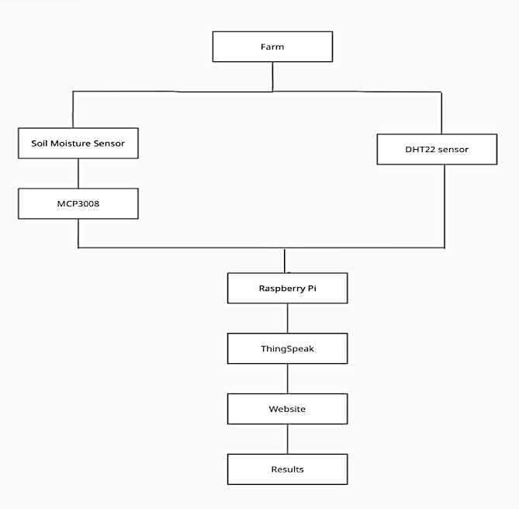
BLOCK DIAGRAM

Slide 12
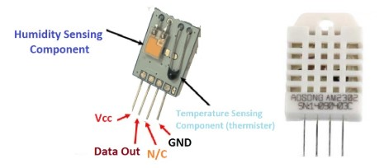
HARDWARE
DHT22 :
The DHT22 is a basic digital temperature and humidity sensor. It uses a capacitive humidity sensor and a thermistor to measure the surrounding air, and spits out a digital signal on the data pin, no analogue input pins needed.
Figure 1: DHT22

Slide 13
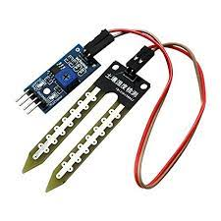
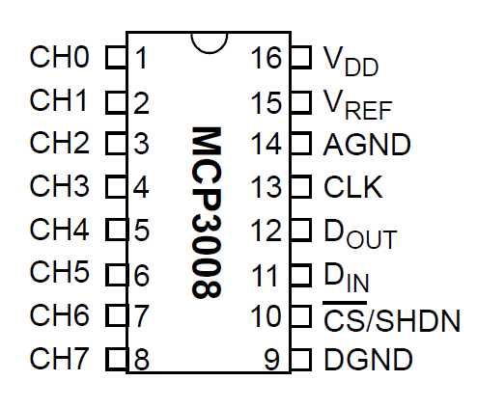
SOIL MOISTURE SENSOR :
Soil moisture sensors measure or estimate the amount of water in the soil. These sensors can be stationary or portable such as handheld probes. Static sensors are placed at predetermined locations and depths in the field, whereas mobile soil moisture probes can measure soil moisture at several locations.
Figure 2: Soil moisture sensor
MCP3008 :
The MCP3008 is a low-cost 8-channel 10-bit analogue to digital converter. The precision of this ADC is similar to that of an Arduino Uno, and with eight channels, you can read quite a few analogue signals from the Pi.
Figure 3: MCP3008

Slide 14
RASPBERRY PI 4 MODEL B :
Raspberry Pi 4 Model B was released in June 2019 with a 1.5 GHz 64-bit quad-core ARM Cortex-A72 processor, on-board 802.11ac Wi-Fi, Bluetooth 5, full gigabit Ethernet (throughput not limited), two USB 2.0 ports, two USB 3.0 ports, 1–8 GB of RAM, and dual-monitor support via a pair of micro HDMI (HDMI Type D) ports for up to 4K resolution.
The version with 1 GB RAM has been abandoned, and the prices of the 2 GB version have been reduced. When used with an appropriate PSU, the Pi 4 is also powered via a USB-C port, enabling additional power to be provided to downstream peripherals.
But the Pi can only be operated with 5 volts and not 9 or 12 volts like other minicomputers of this class. The initial Raspberry Pi 4 board has a design flaw where third-party e-marked USB cables, such as those used on Apple MacBooks, incorrectly identify it and refuse to provide power. In mid-2021, Pi 4 B models appeared with the improved Broadcom BCM2711C0.
The manufacturer is now using this chip for the Pi 4 B and Pi 400. However, the tack frequency of the Pi 4 B was not increased in the factory.

Slide 15
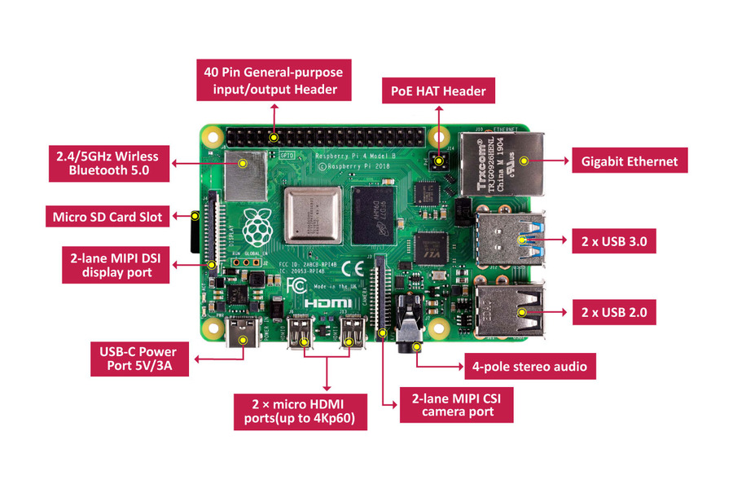
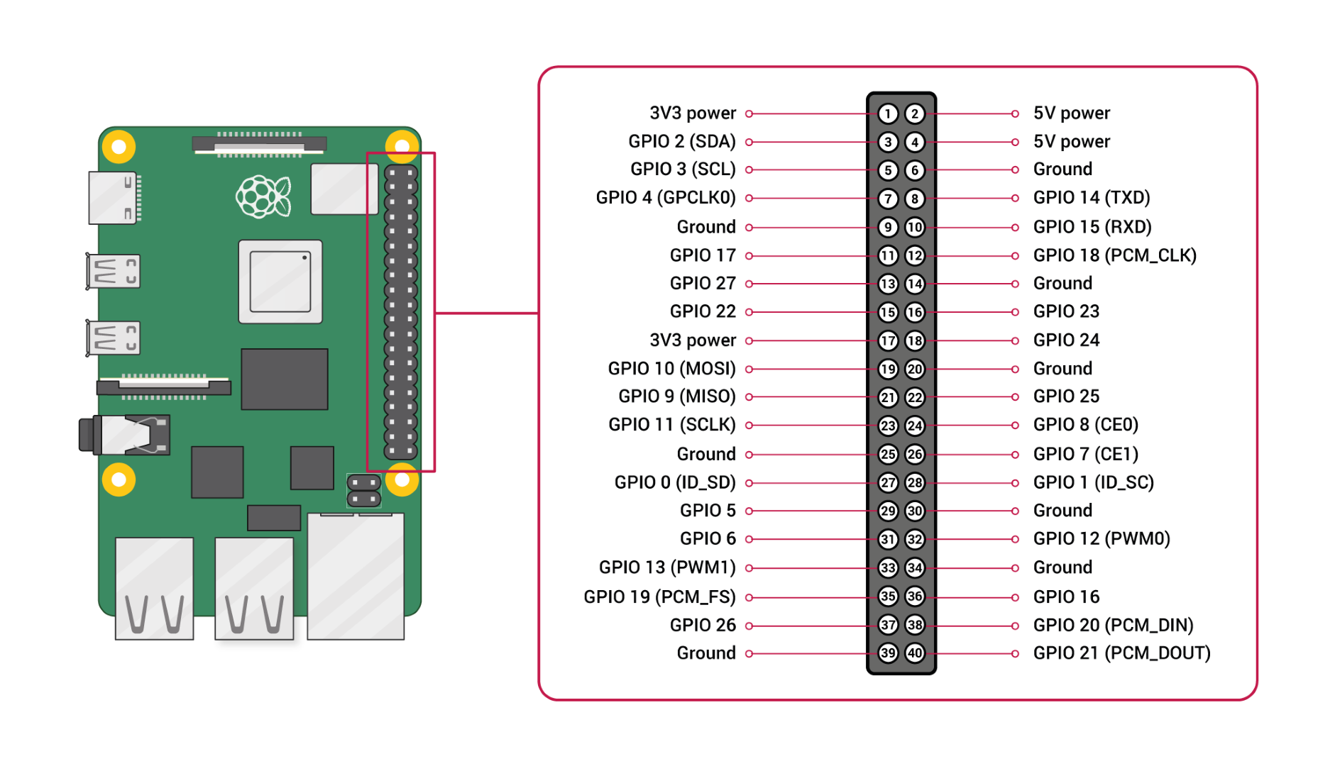
Figure 4: Raspberry pi 4
Figure 5: Pin diagram

Slide 16
BLOCK DIAGRAM OF HARDWARE IMPLEMENTATION

Slide 17
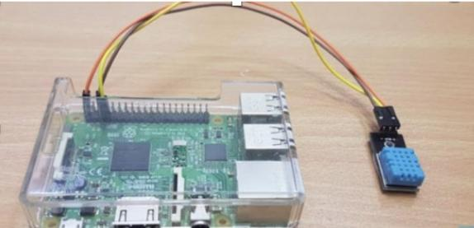
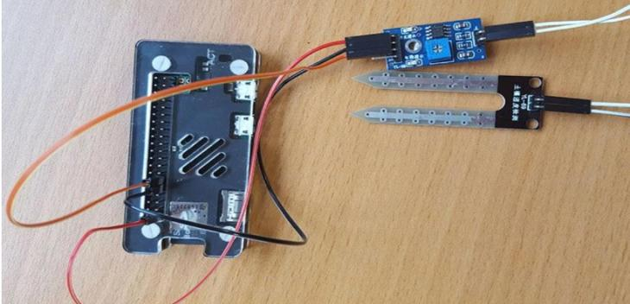
HARDWARE IMPLEMENTATION
The hardware setup comprises of connections between sensors and Raspberry-Pi connected to the monitor.
The sensors used here are Soil Moisture sensor, DHT22 sensor.
Figure 6: DHT22 with Raspberry Pi
Figure 7: Soil Moisture Sensor with Raspberry Pi

Slide 18
SOFTWARE IMPLEMENTATION
LOGISTIC REGRESSION:
Logistic Regression is used for predicting the categorical dependent variable using a given set of independent variables.
It is used for predicting the categorical dependent variable using a given set of independent variables.
In Logistic Regression, we fit an "S" shaped logistic function instead of fitting a regression line, which predicts two maximum values (0 or 1).
The curve from the logistic function indicates the likelihood of something, such as whether the cells are cancerous or not, whether a mouse is obese or not based on its weight, etc.
Logistic Regression is a robust machine learning algorithm because it can provide probabilities and classify new data using continuous and discrete datasets.
Logistic Regression can be used to classify the observations using different types of data and can quickly determine the most effective variables used for the classification.

Slide 19
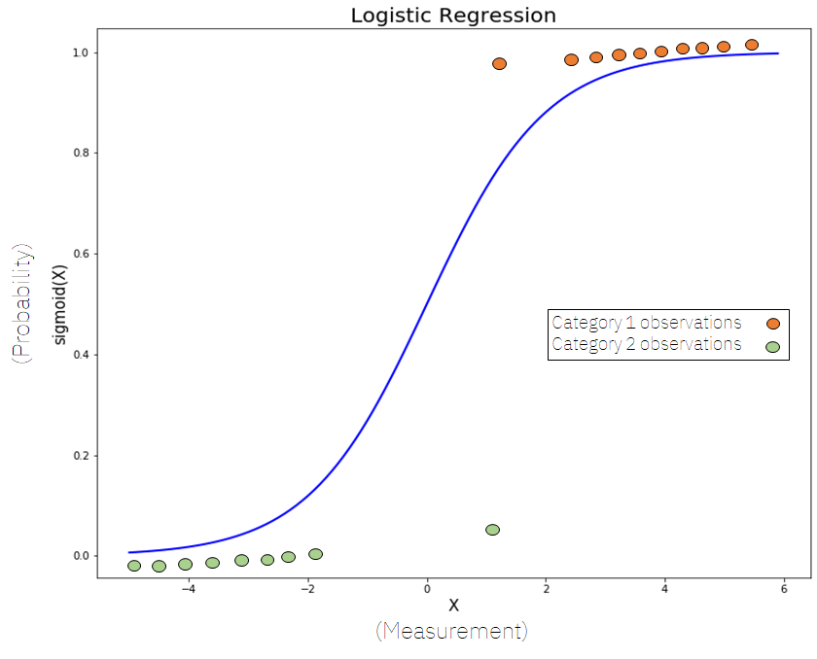
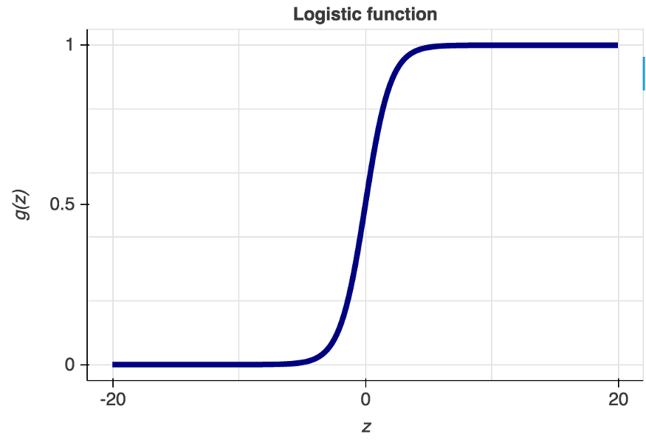
Logistic regression uses the concept of predictive modeling as regression; therefore, it is called logistic regression, but is used to classify samples; Therefore, it falls under the classification algorithm.
The below image is showing the logistic function
Figure 8: Logistic Regression
Figure 9: Logistic Function

Slide 20
RANDOM FOREST ALGORITHM:
Random Forest is a classifier that contains several decision trees on various subsets of the given dataset.
Instead of relying on one decision tree, the random forest takes the prediction from each tree and, based on the majority votes of predictions, predicts the final output.
The more significant number of trees in the forest leads to higher accuracy and prevents the problem of overfitting.
How does the Random Forest algorithm work?
Random Forest works in two-phase first is to create the random forest by combining N decision trees, and the second is to make predictions for each tree created in the first phase.
Step-1: Select random K data points from the training set.
Step-2: Build the decision trees associated with the selected data points (Subsets).
Step-3: Choose the number N for the decision trees you want to build.

Slide 21
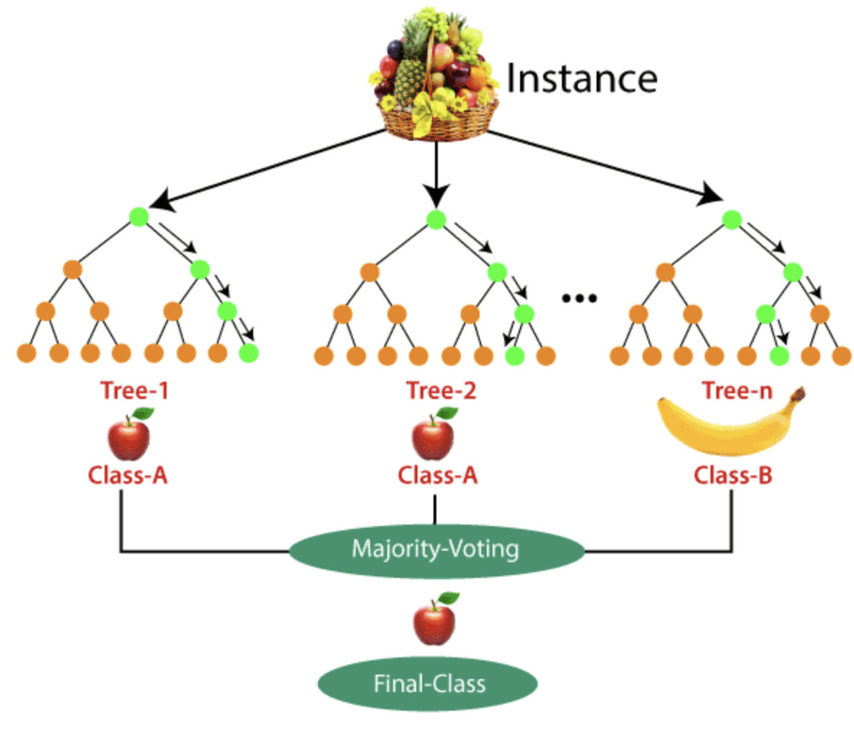
Step-4: Repeat Step 1 & 2.
Step-5: For new data points, find the predictions of each decision tree, and assign the new data points to the category that wins the majority of votes.
It takes less training time as compared to other algorithms.
It predicts output with high accuracy. Even for the large dataset, it runs efficiently.
It can also maintain accuracy when a large proportion of data is missing.
Figure 10: Random Forest Algorithm

Slide 22
BACKPROPAGATION:
A neural network is a group of connected I/O units where each connection has a weight associated with its computer programs. It helps you to build predictive models from large databases. This model builds upon the human nervous system. It allows you to conduct image understanding, human learning, computer speech, etc.
Backpropagation, short for "backward propagation of errors," is an algorithm for supervised learning artificial neural networks using gradient descent.
Given an artificial neural network and an error function, the method calculates the gradient of the error function with respect to the neural network's weights.
The "backward" part of the name stems from the fact that the calculation of the gradient proceeds backward through the network, with the gradient of the final layer of weights being calculated first and the gradient of the first layer of weights being calculated last.
Partial computations of the gradient from one layer are reused in the gradient computation for the previous layer. This backward flow of the error information allows for efficient computation of the gradient at each layer versus the naive approach of calculating the gradient of each layer separately.

Slide 23
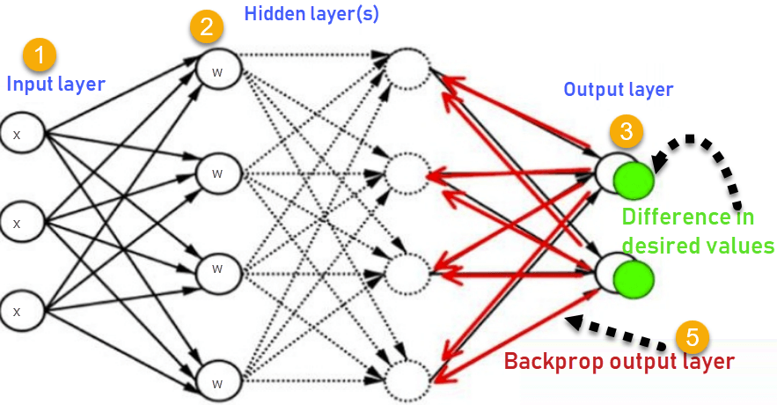
BACKPROPAGATION:
Inputs X, arrive through the preconnected path.
Input is modeled using real weights W. The weights are usually randomly selected.
Calculate the output for every neuron from the input layer, to the hidden layers, to the output layer.
Calculate the error in the outputs Error= Actual Output – Desired Output
Travel back from the output layer to the hidden layer to adjust the weights such that the error is decreased.
Figure 11: Neural Network

Slide 24
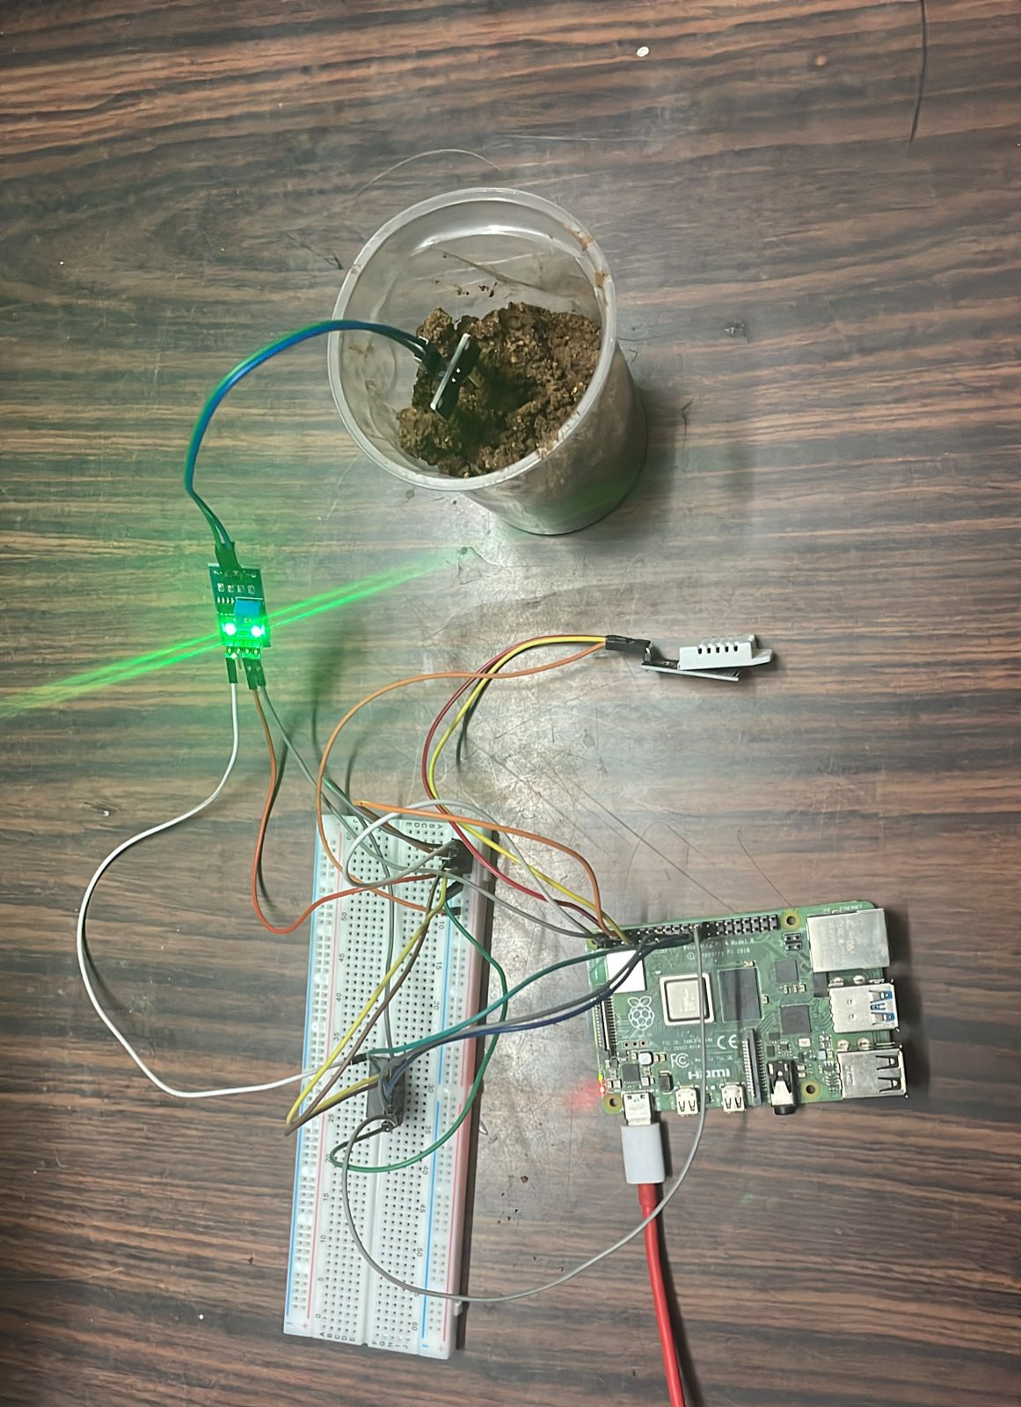
RESULTS
Hardware Prototype for Data Collection:
Below is the hardware prototype made by incorporating with soil moisture, temperature and humidity sensors with for data collection.
Figure 12: Hardware Prototype

Slide 25
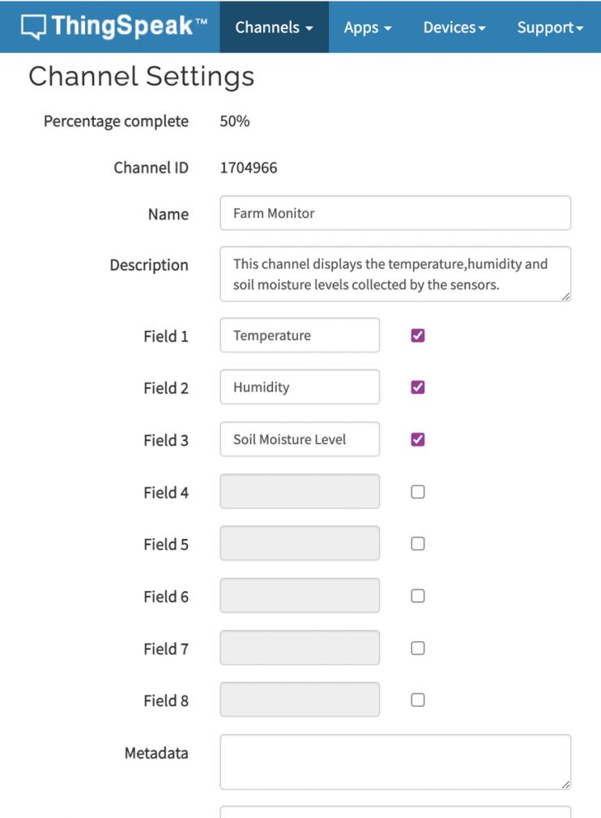
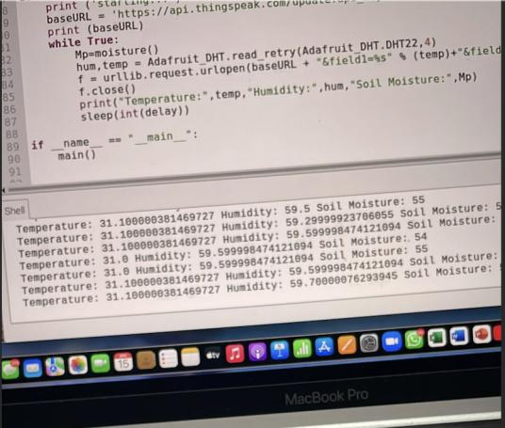
RESULTS
Transmission of Data collected to ThingSpeak Cloud:
Figure 13: Data Collected by sensors
Figure 14: Channel Setup in ThingSpeak

Slide 26
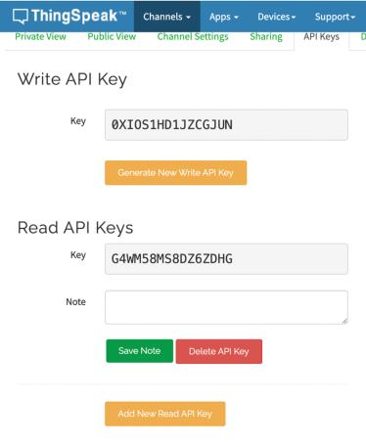
RESULTS
Transmission of Data collected to ThingSpeak Cloud:
Figure 15: API Key Generation in ThingSpeak

Slide 27
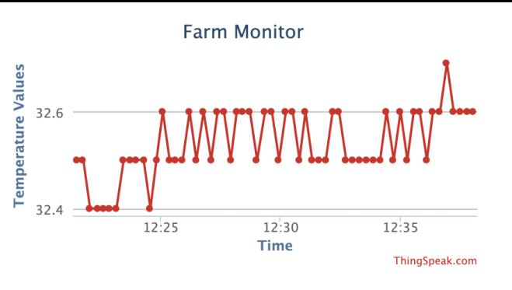
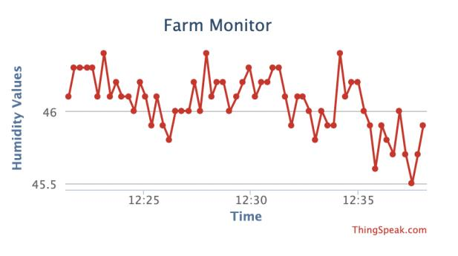
RESULTS
Transmission of Data collected to ThingSpeak Cloud:
Figure 16: Temperature Values in Cloud
Figure 17: Humidity Values in Cloud

Slide 28
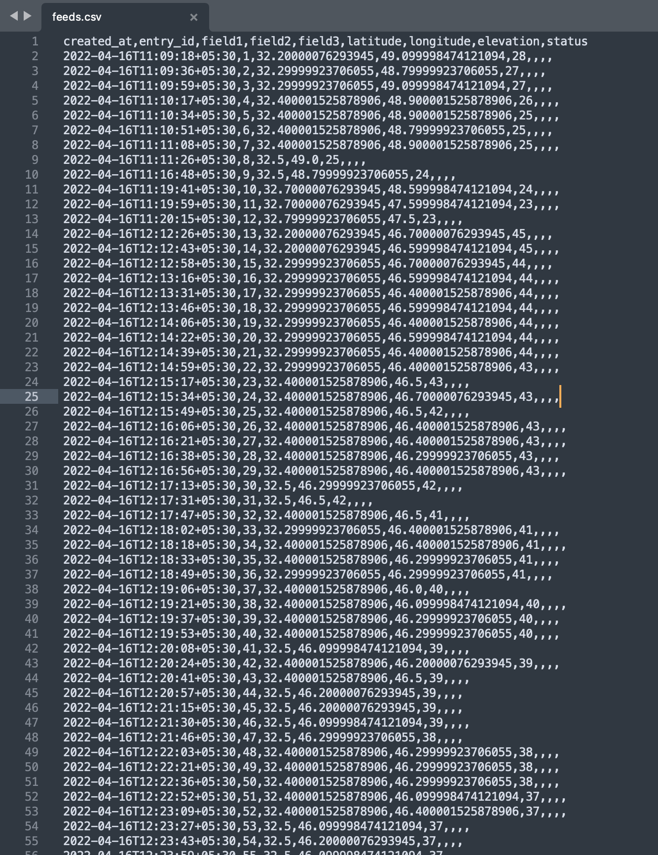
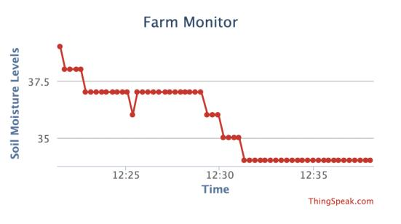
RESULTS
Transmission of Data collected to ThingSpeak Cloud:
Figure 18: Soil Moisture Values in Cloud
Figure 19: Data in cloud imported in CSV form

Slide 29
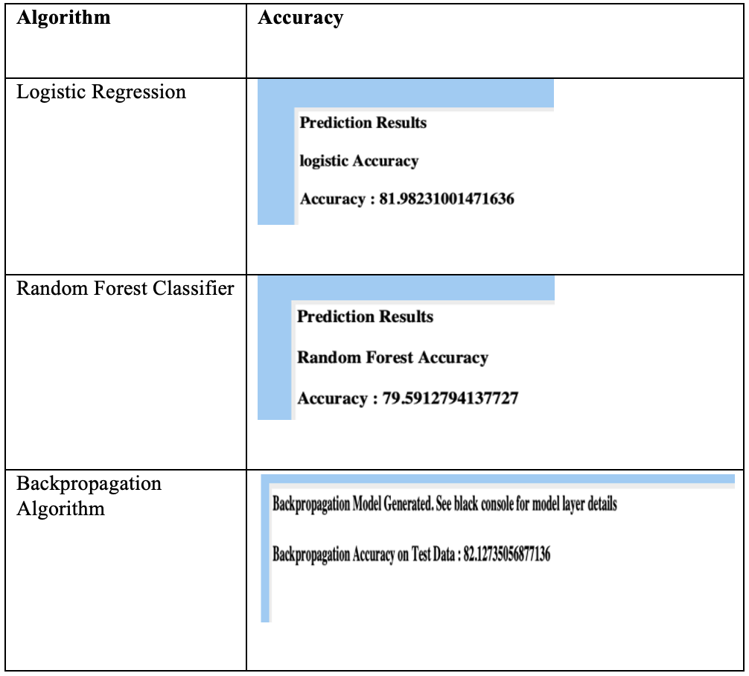
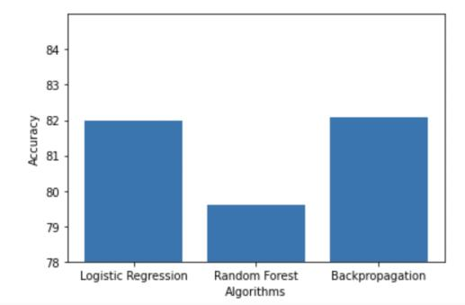
RESULTS
Machine learning models (Logistic Regression, Random Forest Algorithm, and Backpropagation Algorithm) are built for predicting rainfall. Their accuracies are compared in the below table.
Figure 20: Graph comparing accuracies shown in adjacent table

Slide 30
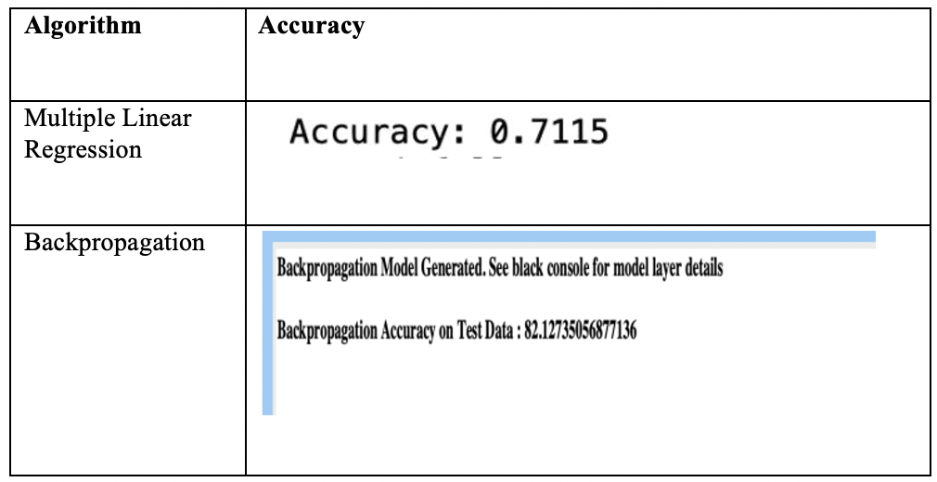
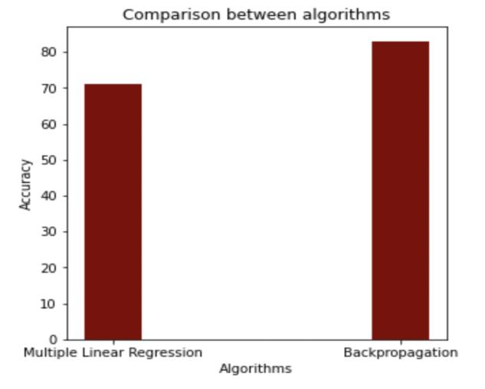
RESULTS
Accuracy of Multiple Linear Regression algorithm used in base reference paper is compared with the Back Propagation algorithm.
Figure 21: Graph comparing accuracies shown in adjacent table

Slide 31
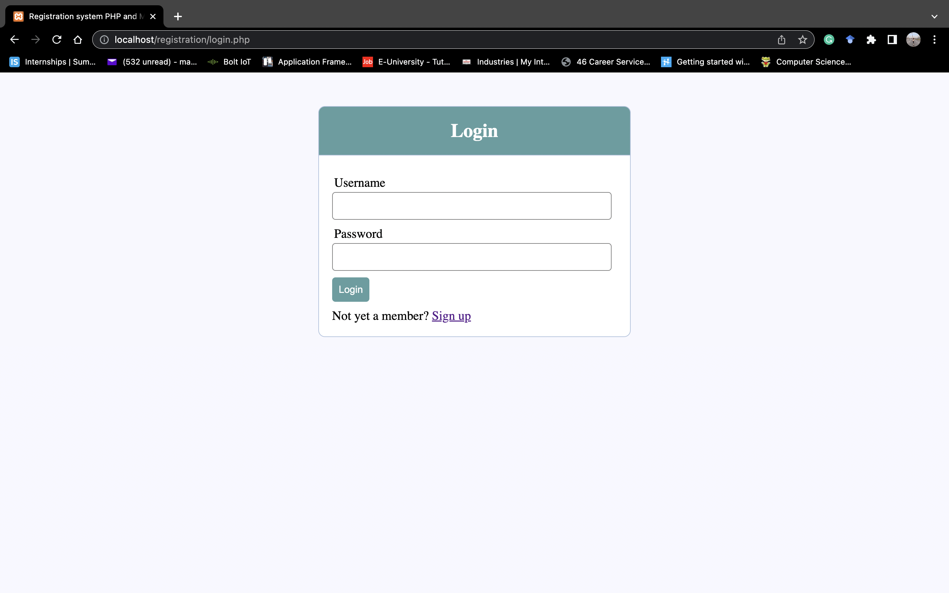
RESULTS
Webpage that displays the farm analysis that was done in the ThingSpeak cloud.
Figure 22: Login Page of website

Slide 32
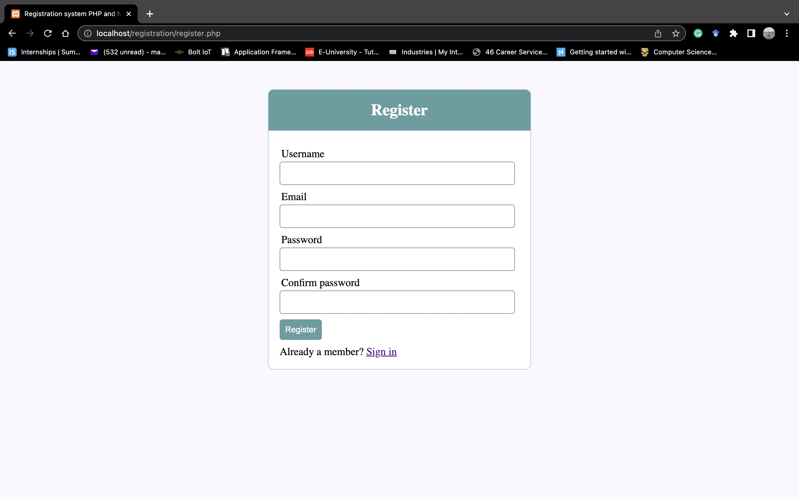
Figure 23: Registration Page of website

Slide 33
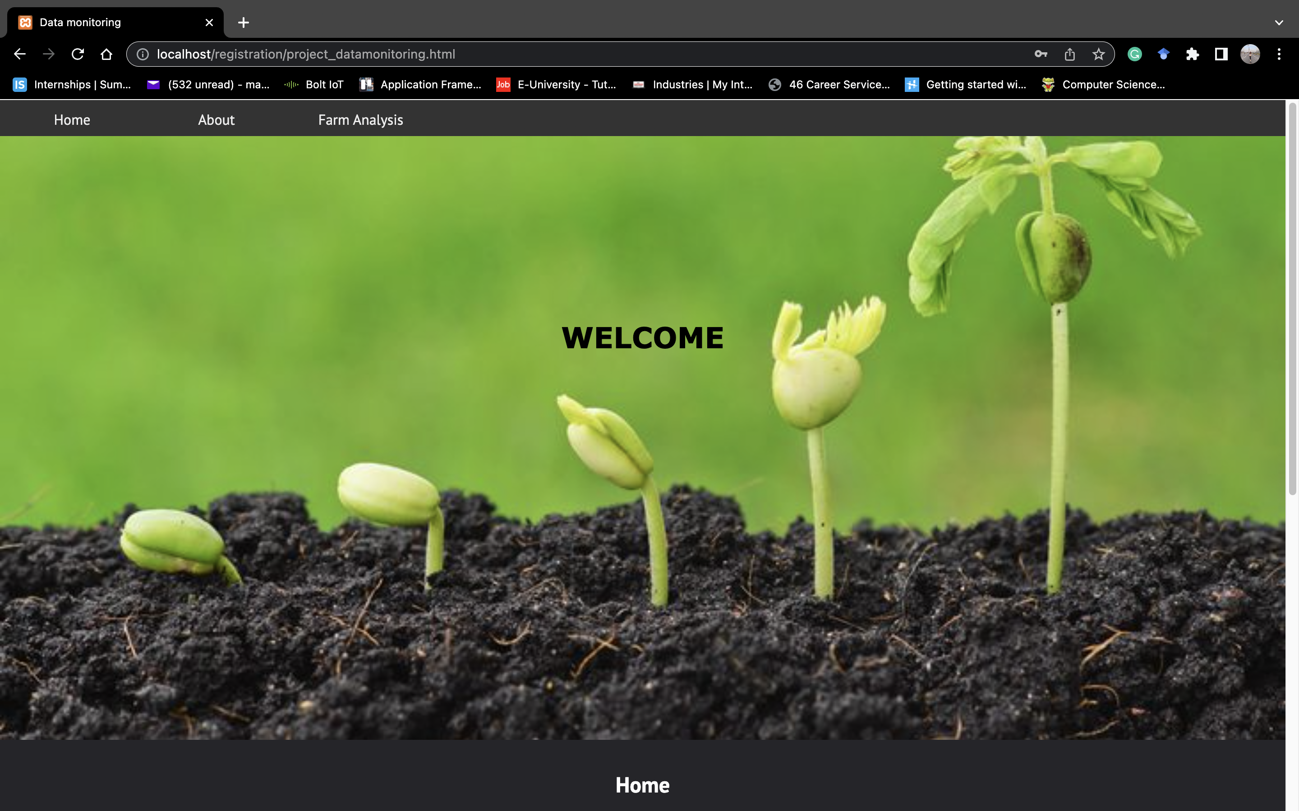
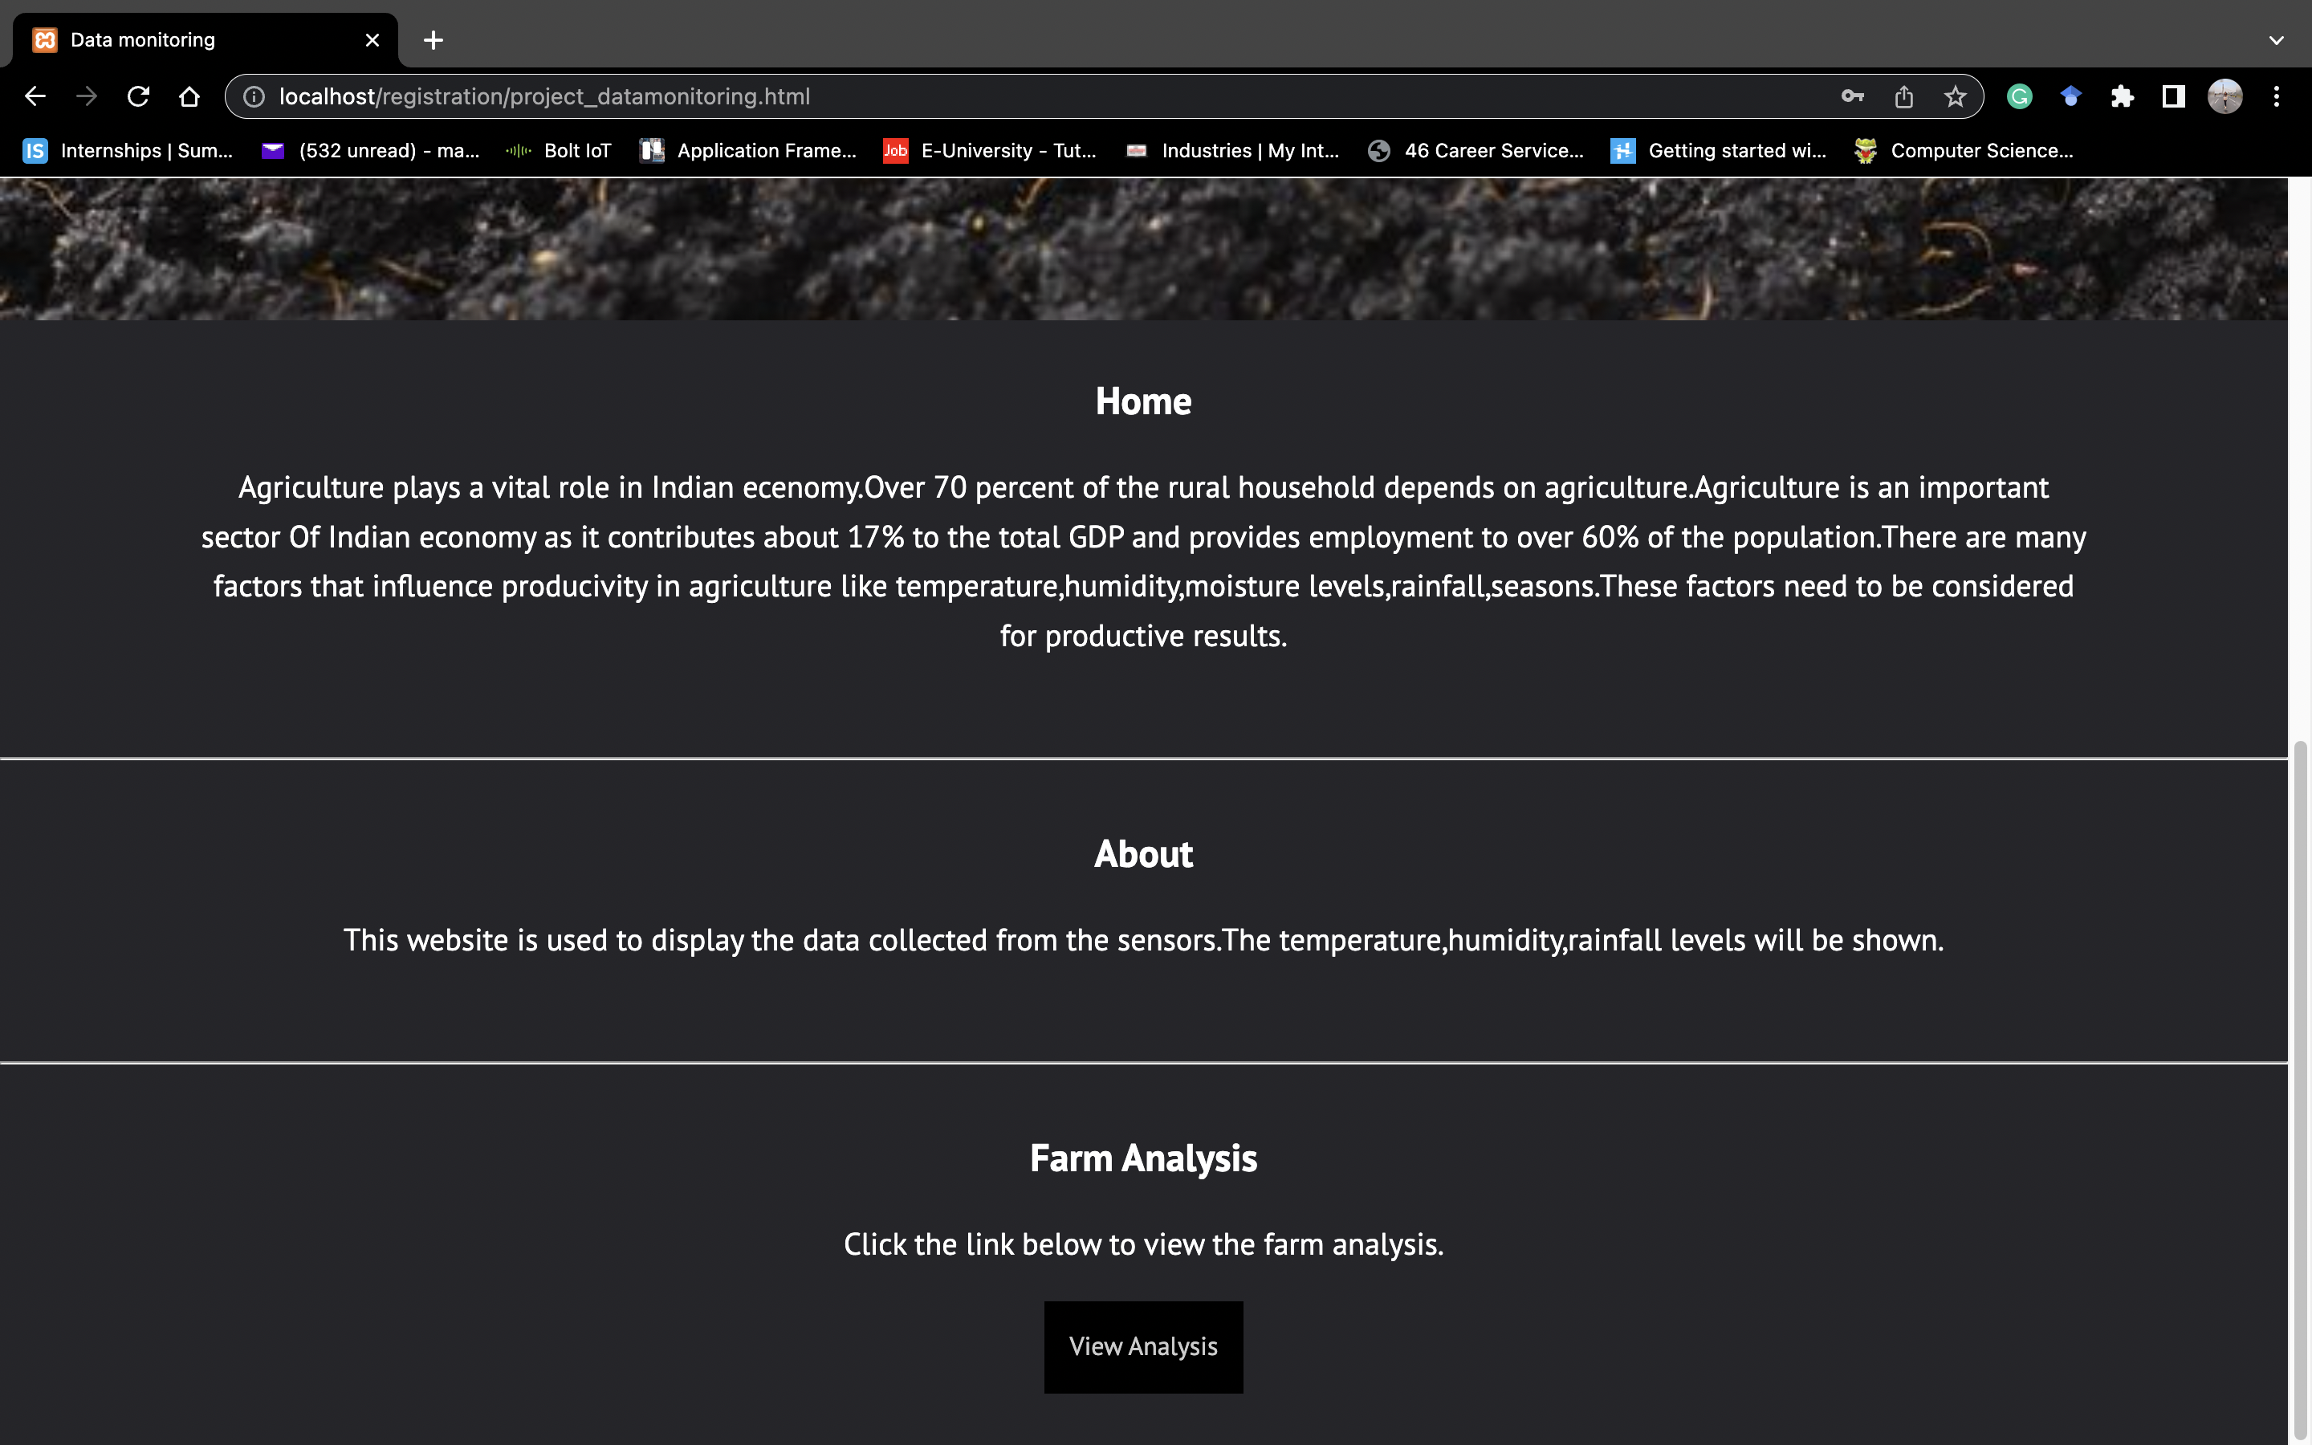
Figure 24: Home Page of website
Figure 25: About Page of website

Slide 34
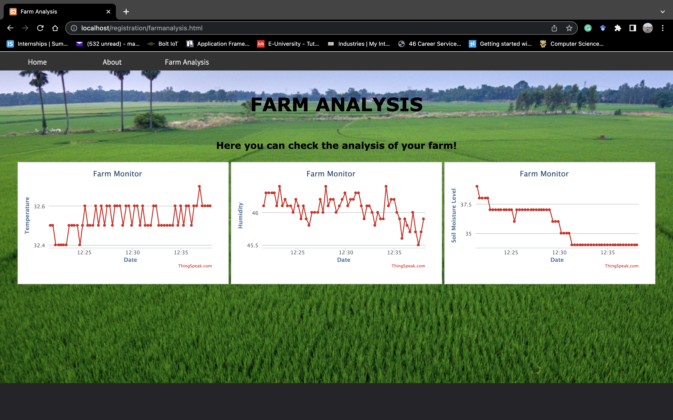
Figure 26: Farm Analysis of website

Slide 35
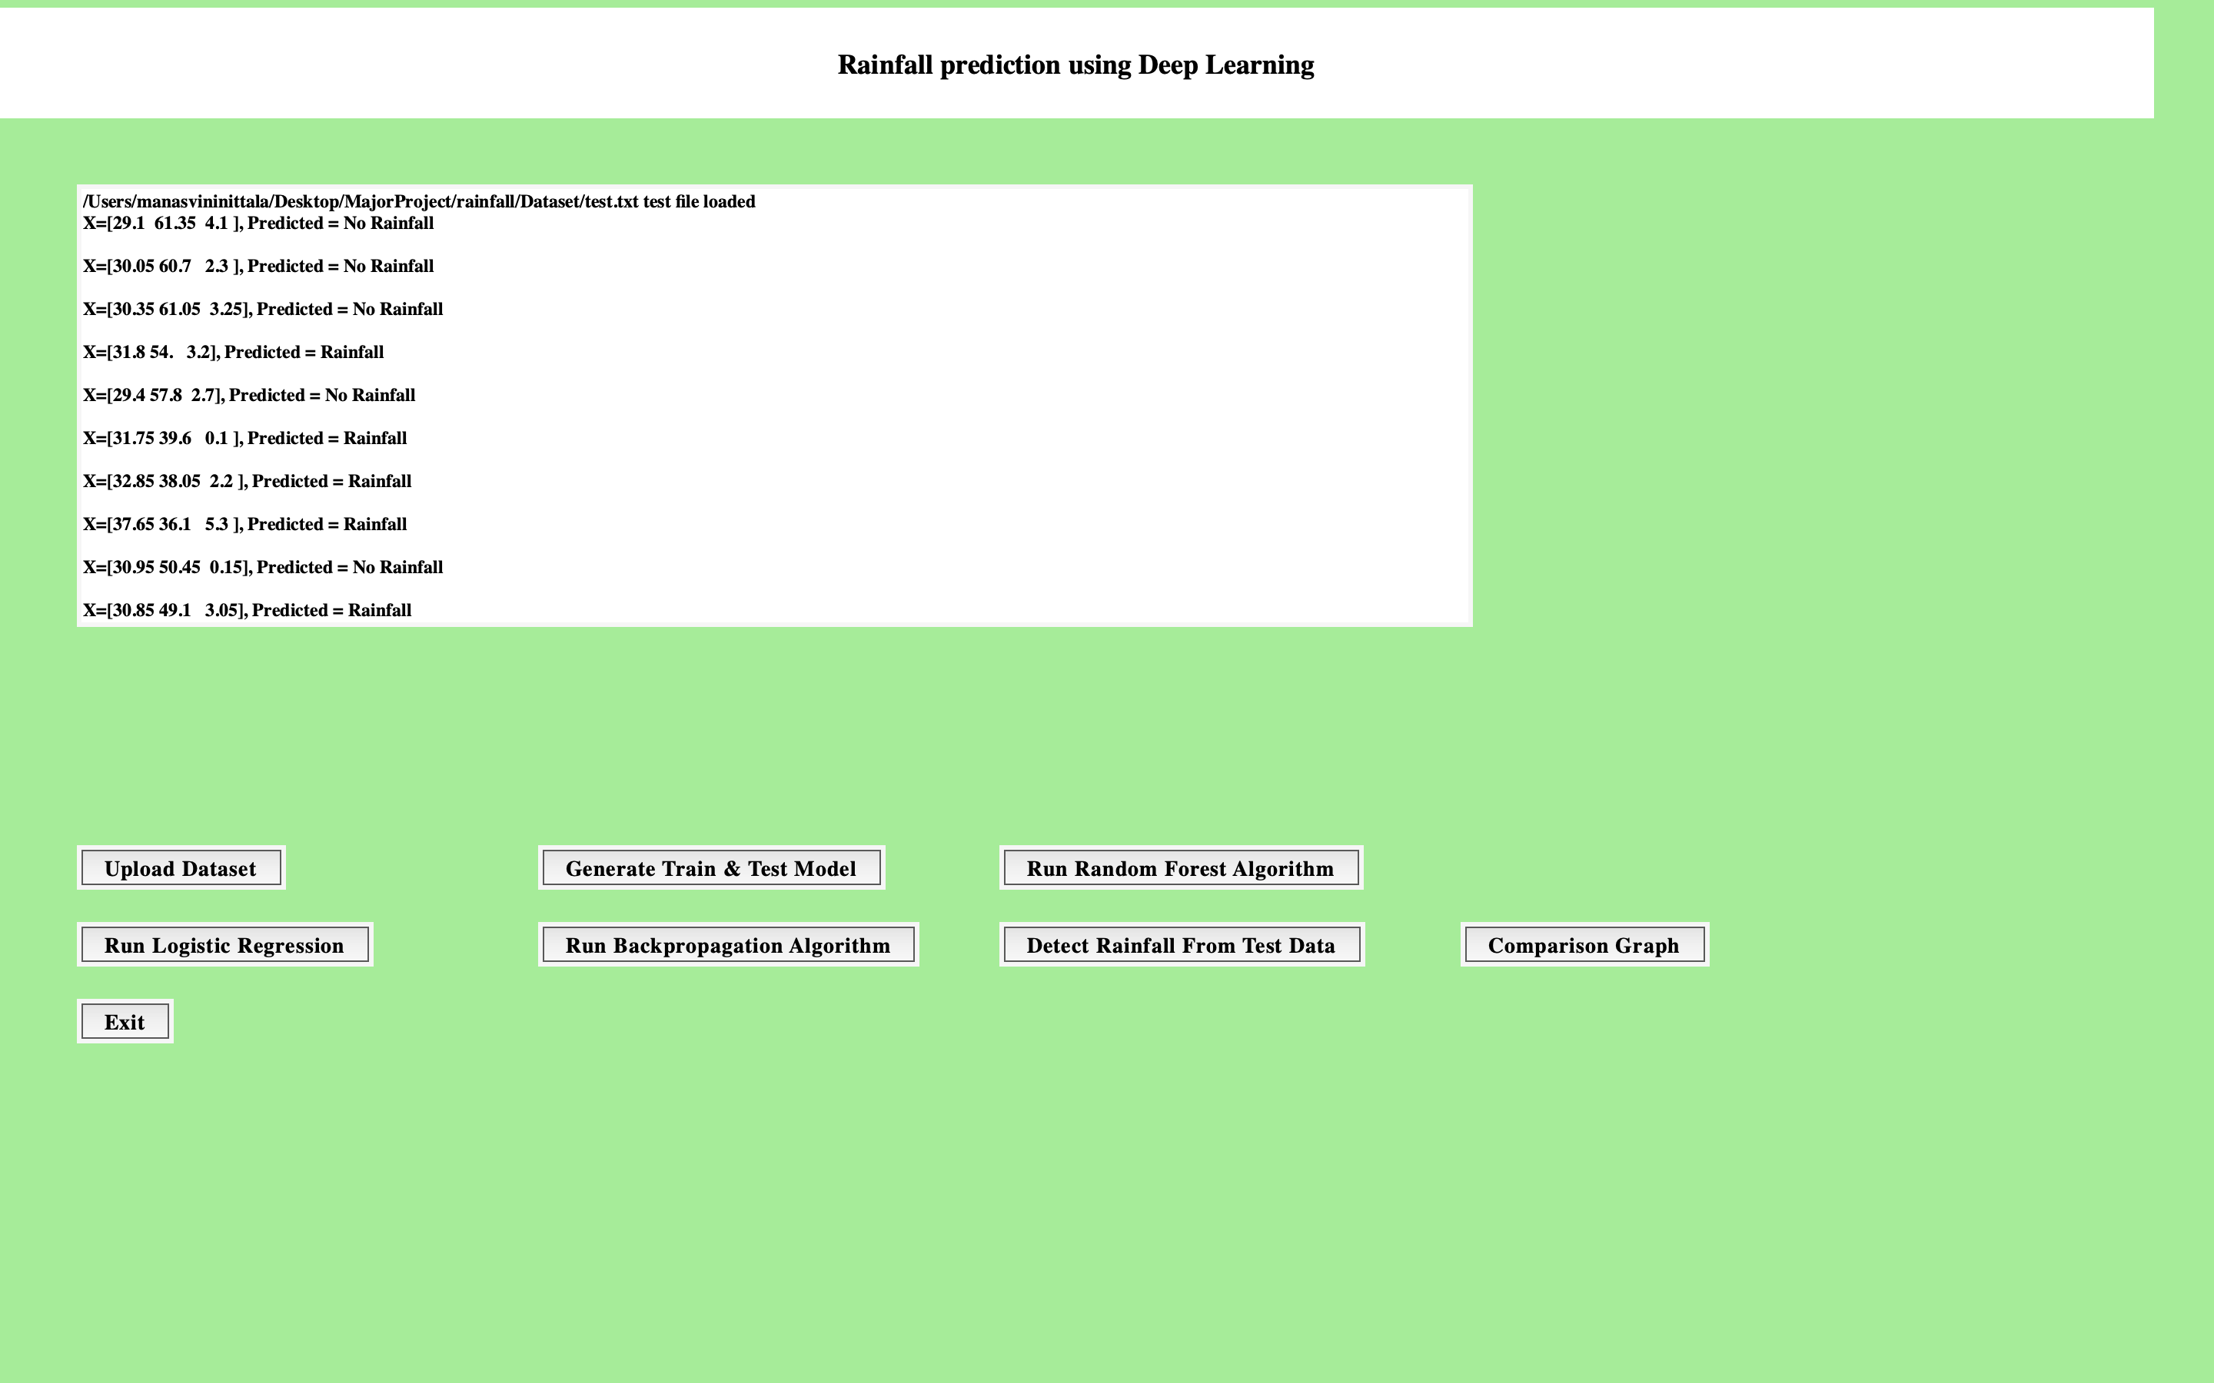
Figure 27: Prediction on data from cloud

Slide 36
CONCLUSION
This project allows us to track soil moisture, temperature and humidity levels and predict rainfall. A prototype is developed and data collected from the sensors is transmitted to the ThingSpeak cloud. Machine learning models using Logistic Regression, Random Forest Algorithm, and Backpropagation Algorithm for predicting rainfall are developed. A webpage that displays the farm analysis that was done in the ThingSpeak cloud is also developed to predict the rainfall.
The data is analysed and posted on the webpage. This data is used to plan the harvesting and sowing the seeds. The collected data is stored in the cloud and can be used by the farmers in the future also. This can aid in reducing the losses that farmers have suffered due to poor crop choices and forecasting unfavourable conditions that have existed for many years. The system demonstrates the capacity to focus on many farm factors. Thus the farmer can utilize the farm analysis to increase the productivity of the farm.

Slide 37
FUTURE SCOPE
Additional sensors, such as wind speed, pH, and air quality sensors, could be added to this model. These sensors will assist in the overall management of the farm.
A camera and fiber optic sensor can relate to the nodes. The camera captures images periodically, and image processing is done on these images to determine the growth of the crop and the diseases; these images can also help in identifying the pests on the observation of any abnormalities.

Slide 38
references
[1] MAI Navid, NH Niloy, “Multiple Linear Regression for Predicting Rainfall”, Science Publishing Group, Vol.6, No.1, ISSN: 2328-5966,2018.
[2] Ravi Kishore Kodali and Archana Sahu , “An IoT Based Soil Moisture Monitoring on Losant Platform”, International Journal of Advanced Research in Computer and Communication Engineering Vol. 5, Issue 6, ISSN (Online) 2278-1021 ISSN (Print) 2319 5940, June 2016.
[3] Rakib Raihana, Gaozhi Xiao, Zheng Liu, "IoT Empowered Smart Green House Farming”, IEEE Journal of Radio Frequency Identification, Vol. 4, No. 3, September 2020.
[4] Chetan Dwarkani M, Ganesh Ram R, Jagannathan S, R. Priyatharshini “Smart Farming System Using Sensors for Agricultural Task Automation”, in 2015 IEEE International Conference on Technological Innovations in ICT for Agriculture and Rural Development (TIAR 2015).
[5] Neelam Mishra, Hemant Kumar Soni, Sanjiv Sharma, A K Upadhyay, “Development and Analysis of Artificial Neural Network Models for Rainfall Prediction by Using Time-Series Data”, I.J. Intelligent Systems and Applications, 2018, 1, 16-23 Published Online January 2018 in MECS (http://www.mecs-press.org/) DOI: 10.5815/ijisa.2018.01.03

Slide 39
THANK YOU!

